Slide 1
Class of 2020
The Woodlands High School
Senior Awards

Slide 2
Welcome by Dr. Landry

Slide 3
Perfect Attendance 9th – 12th Grades
Ghassan Ali Ahmad
Grace Linh Huong Baldwin
Abby Damaris Bonzon
Brandon Heydon Carmichael
Tyler Jack Clough
Gavin Ellis
Jeanne Marie Gancel
Kiaya Rene Hairston
Naomi Joy Hernandez
Christopher Wilson Hurt
Neel Sachin Kudchadkar
Eduardo Pietromonaco Lucena
Alejandro Esteban Nunez Bravo
Nicole Ann Marie Petit
Seth Jacob Seneca
Tonya Solange Smith
Liesl Ann Wilker
Kaitlyn Grace Yost

Slide 4
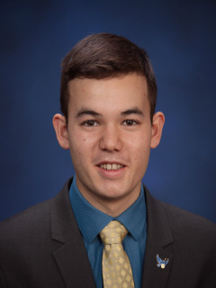
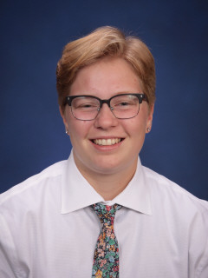
Highlander Excellence Award $1,000 Scholarship
Tyler Clough
Jordan Pimentel

Slide 5
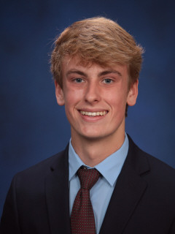
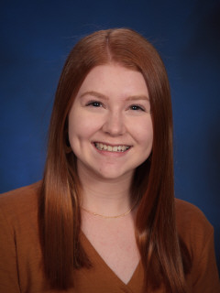
Highlander Achievement Award $500 Scholarship
Colby McClaugherty
Elizabeth Marlow

Slide 6
Honor Graduate Designations
Summa Cum Laude: Students who are in the top 5% in the graduating class; Designated by a gold stole at graduation
Magna Cum Laude: Students who fall between 5% and 10% in the graduating class; Designated by a grey stole at graduation
Cum Laude: Students who fall between 10% and 15% in the graduating class; Designated by a red stole at graduation

Slide 7
AP Scholar Designation
AP Scholar:
Students who took at least 5 AP exams during their four years of high school. This designation is different than the AP Honor Awards that are given out by College Board based on AP exam scores (i.e., AP Scholar with Honor and AP Scholar with Distinction). Students are notified by College Board if they achieve one if these distinctions.

Slide 8
UIL Scholar Designation
UIL Scholar:
Students who were in the top 10% of their graduating class and participated in at least one year of a UIL activity during their four years of high school.

Slide 9
Military Appointments and Enlistments
Military Cords:
The Woodlands High School started a new tradition this year by recognizing students who will be attending a military Academy or will be enlisting in one of the Armed Forces. These 14 students received a red, white, and blue cord to wear at graduation.
For the Class of 2020, we had 3 appointments to the US Air Force Academy, 2 ROTC/Enlistments for Air Force, 4 ROTC/Enlistments for Army, 2 Enlistments for Marines, and 3 Enlistments for Navy.

Slide 10
Sport and Organization Scholarships
Our students participate in many activities during their high school careers. As students and families look at the attached Senior Award Program, many booster clubs have honored their seniors for their service through scholarships such as TWHS Quarterback Club, TWHS Excellence in Theater Awards, and TWHS Highstepper Parent Club Award.
We are extremely proud of our students who participated in these activities during the course of their four years in high school!

Slide 11
Other Types of Scholarships
The remainder of the Senior Awards program consists of the various scholarships and awards that students received from local organizations, national organizations, and universities. Some students received Academic Scholarships and/or Athletic Scholarships from various universities across the country.
Additionally, many students received local scholarships from our community partners such as the Knights of Columbus, Houston Livestock Show and Rodeo, and Pavilion Partners.

Slide 12
TWHS Class of 2020 Scholarship Total
$10,637,632.00

